Slide 1

UE20CS390A Capstone Project Approval
Project Title : Detection and Prevention of Covert
Channels using Machine Leaning
Project ID : PW23_SVM_01
Project Guide : Dr. Sapna V M
Project Team : 153_184_193_290

Slide 2
Content Outline
Problem Statement
Scope and Feasibility study
Applications/Use cases
Expected Deliverables
Capstone (Phase-I & Phase-II) Project Timeline
Any other information

Slide 3
Problem Statement
A network covert channel is a secret communication channel used to obscure information sharing between end points and circumvents existing security barriers over a network. Covert channels pose a serious risk to the privacy and security of a personnel/organisation as they go mostly undetected because of the least generalizability and scalability of the covert channel detection and analysis tools. A major requirement concerns the agility of deploying security agents at runtime, especially to effectively address emerging and advanced attack patterns.
Our main aim for the project is to develop a tool that implements detection and prevention of network covert channels. We would orient our work giving more emphasis on storage and timing covert channels.

Slide 4
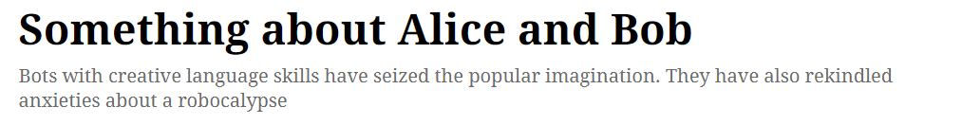
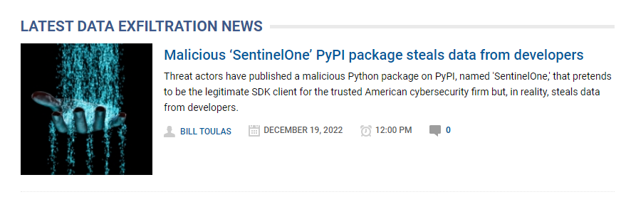
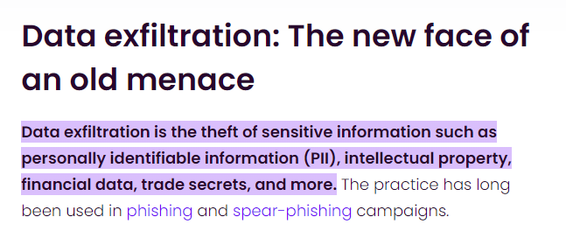

Slide 5
Scope and Feasibility study
Network covert channels are increasingly used to endow malware with stealthy behaviors, for instance to exfiltrate data or to orchestrate nodes of a botnet in a cloaked manner.
Hidden communication is of paramount concern for governments and companies, because it can conceal data leakage and malware communication, which are crucial building blocks used in cybercrime.
To this aim, we reviewed the relevant literature by considering approaches that can be effectively deployed to detect covert communication threats observed in the wild.

Slide 6
Obtaining public network traffic for testing covert channel detection is challenging and there are no public datasets available. Thus, we use tools to create our own dataset.
Noisy channels - When covert traffic coexists with normal traffic in the same flow, the detection of the covert channel becomes more difficult.
Covert channels in address fields and bouncing covert channels. Bouncing covert channels consist of covert communications that use intermediate servers to prevent detection and tracking of sources.
Covert channels modeled according to field distribution properties. covert channel techniques use the statistical characteristics of IP services to mask covert information which are hard to detect.

Slide 7
Network Covert channels are often characterized by low data rates; hence detection is quite challenging. The defenders do not know in advance where the secret information has been hidden.
We are using BPF to aid in the detection of covert communication. We can use tools and Machine Learning Algorithms to analyze the traffic and detect covert communication with least incurred cost.

Slide 8
Applications/Use cases
As with most security concepts, however, covert channels do have a dark side. Given that they provide a stealth and secure communication channel, they can undoubtedly be used to establish connections that are theoretically prohibited by the security policy.
Misuse of Covert channels can be:
Information leak from a high-security network.
Secret communication in a prison or workplace monitoring
Bypassing internet censorship or government surveillance
Concealing malware command and control communications.
Hence our project aims at detecting such channels and preventing them.

Slide 9
The covert channel detection system can be used for following purposes :
Can be used in defense to monitor suspected network for covert channel
Can be used to monitor the packets of private network with the internet​
Can be installed in any computer to check for malware exfiltration of data

Slide 10
Expected Deliverables
Capstone-I deliverables
Capstone-II deliverables
Dataset generation
Training ML model for detection of covert channel
Designing the test environment
Development of Covert channel detection tool
Development of Covert channel prevention tool
Integration of all the components
Problem Statement Identification
Feasibility Study
Literature Survey
Writing a Survey Paper
Deciding the workflow
Designing the architecture

Slide 11
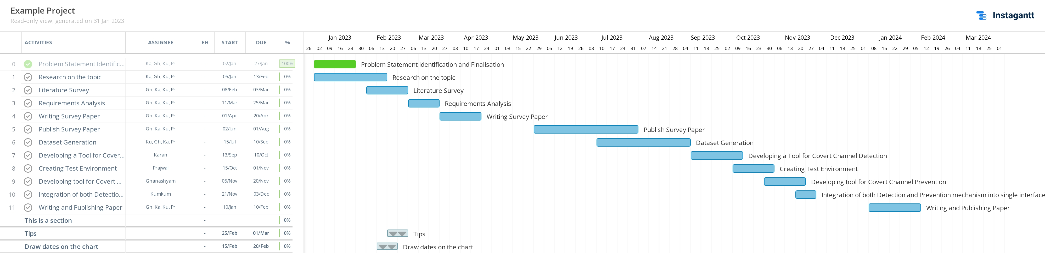
Capstone (Phase-I & Phase-II) Project Timeline

Slide 12
Work Break Down

Slide 13
THANK YOU

